Slide 1
SIRUS PCIE 5.0Gbps Simulation Report
Red Kuo
2017.12.18

Slide 2
Summary
PCIE 5Gbps
Net |  | L/B only | Pass Criteria
Site1 | SDD21@2.5GHz | -0.20dB | None
 | SDD11@2.5GHz | -27.22dB | None
 | Eye height | 769.1mV | None
 | Jitter | 1.6ps | None
 | Eye Width | 199.6ps | None

Slide 3
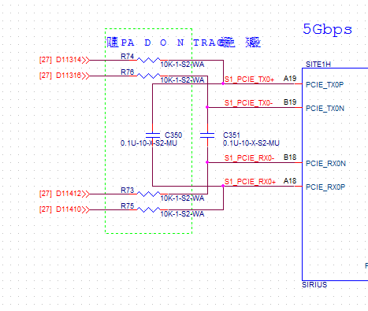
PCIE Schematic

Slide 4
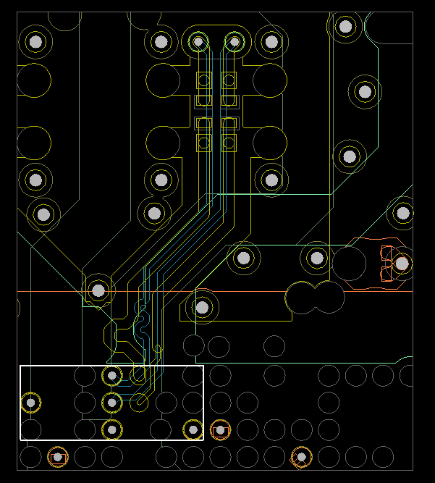
PCIE Layout

Slide 5
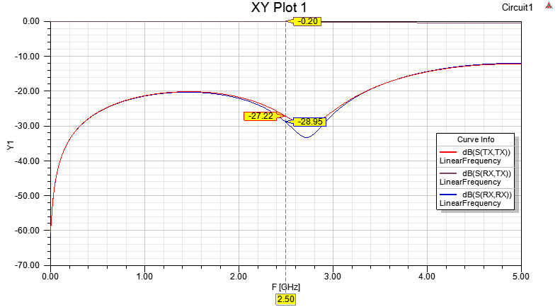
S-parameter
Sdd21 : -0.20dB @ 2.5GHz
Sdd11 : -27.22dB @ 2.5GHz

Slide 6
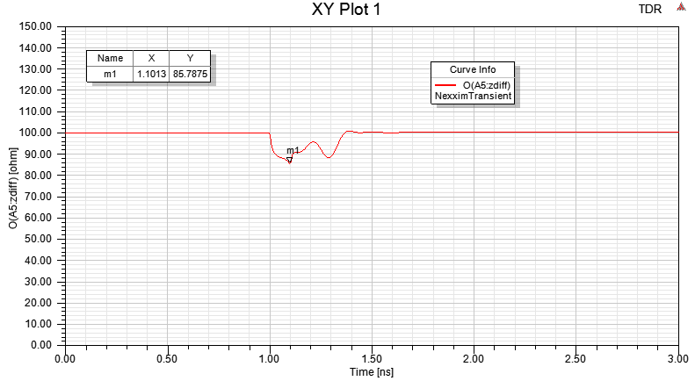
Impedance

Slide 7
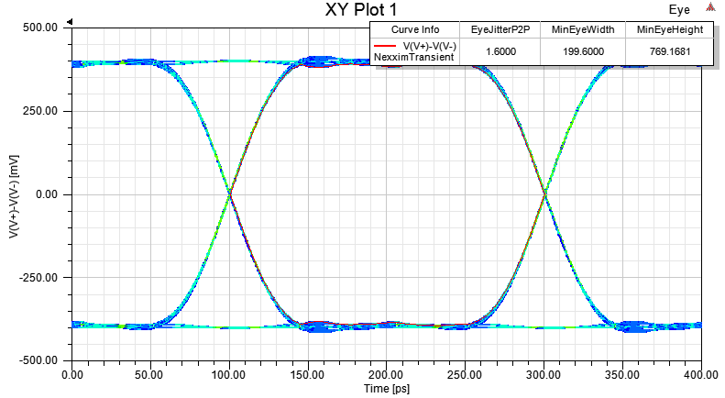
Eye Diagram
Jitter: 1.6ps, Eye Height: 769.1mV Eye Width199.6ps

